Slide 1
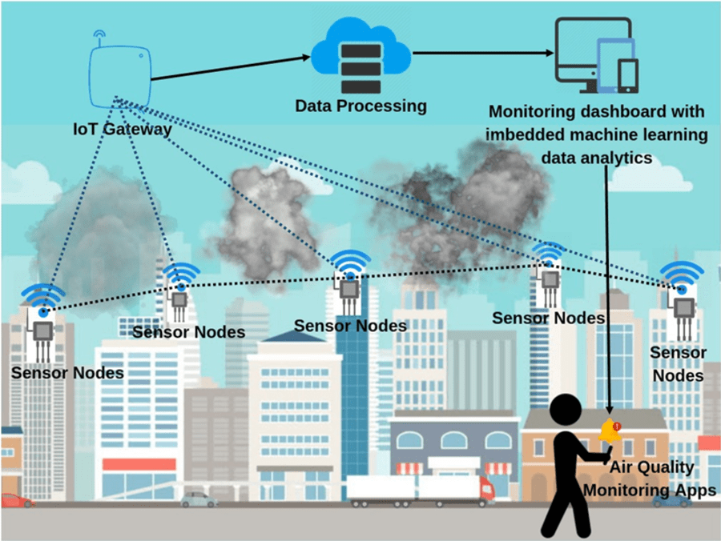
IoT BASED AIR POLLUTION MONITORING SYSTEM
Under the guidance of Dr. MALLIKARJUNA A

Slide 2
Abstract
According to population reference bureau, at present, a total number of the vehicles is 1.2 Billion according to survey and it will be 2 Billion up to 2035. Then pollution level has increased due to various factors like the increase in population, increased vehicle use, industrialisation and urbanisation which results in harmful effects on human wellbeing by directly affecting health of population exposed to it. In order to monitor, in this project we are proposing an IoT based air pollution monitoring system in which we will monitor the air quality over a web server using internet and will trigger a alarm when the air quality goes down beyond a certain level, means when there are sufficient amount of harmful gases are present in the air like CO2, smoke, alcohol, benzene and NH3. In this IoT project, we can monitor the pollution level from anywhere using our computer or mobile.

Slide 3
INTRODUCTION
Air pollution is the reasons of many known problems of the current world which includes greenhouse effects, global warming, depleting the ozone layer, climate change and the reason of extinction of different animals and many more are endangered.
Due to air pollution, air is contaminating day by day which means the standard quality of air is decreasing which have negative effects on our health causing different severe diseases like lung diseases and asthma, allergic reactions and cardiac diseases.
Therefore, to overcome the issues of toxic gas poisoning in the surroundings, the development of an air quality monitoring system capable of providing notification updates on the air quality levels is very important.
Our system uses an MQ-2, MQ-4, MQ-7 and MQ-135 sensors to detect sulphur dioxide, Methane, carbon monoxide and Ammonia (NH₃), sulfur (S), Benzene (C₆H₆), CO₂, and other harmful gases and smoke.
Internet of things (IoT) based air quality monitoring with low-cost energy by using Esp32 Microcontroller on the integration with Blynk App.

Slide 4
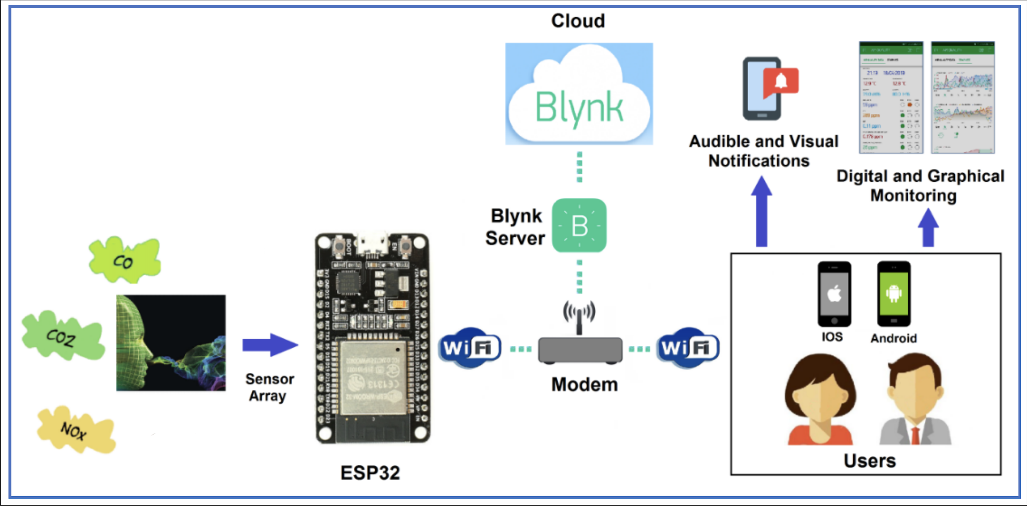
INTRODUCTION
Fig - 1: Introduction to IoT based Air Pollution Monitoring System

Slide 5
Objectives
Design a circuit using the ESP32 microcontroller and multiple gas sensors (MQ2, MQ4, MQ7, and MQ135) to measure the concentration of different pollutants in the air.
Develop a Blynk mobile application that can communicate with the ESP32 module and display real-time air quality data.
Integrate the Blynk application with the ESP32 module and gas sensors to enable remote control of the system and real-time monitoring of air quality data.
Test the system in different environments to evaluate its accuracy and reliability in detecting various air pollutants.
Provide an alarm or notification system to alert users when air pollution levels exceed safe limits.

Slide 6
Problem Statement
Air pollution is a major global issue that affects the health and wellbeing of people.
There is a need for a low-cost, portable, and real-time air quality monitoring system that can provide accurate and timely information to individuals and authorities.
The use of IoT technology in air quality monitoring has the potential to provide a solution to this problem by allowing for remote monitoring and data collection from various locations.
However, there is a need for a comprehensive system that can measure multiple pollutants and provide a user-friendly interface for data visualisation and analysis.
The goal of this project is to design and develop an IoT-based air pollution monitoring system using ESP32 and gas sensors (MQ2, MQ4, MQ7, and MQ135) that can measure multiple pollutants in real-time and provide users with a user-friendly mobile app interface.

Slide 7
METHODOLOGY
Develop an IoT-based air pollution monitoring system using ESP32 and gas sensors such as MQ2, MQ4, MQ7, and MQ135.
Create a hardware module to collect real-time data on air quality in a particular area.
Implement the Blynk platform for data visualisation and monitoring on a mobile application.
Analyse and measure the concentrations of various harmful gases like carbon monoxide, ammonia, and other particulate matter in the air.
Provide warnings or messages on the mobile application based on the gas concentrations and temperature readings.
Increase awareness about air pollution levels in the community and encourage individuals to take steps towards reducing pollution levels

Slide 8
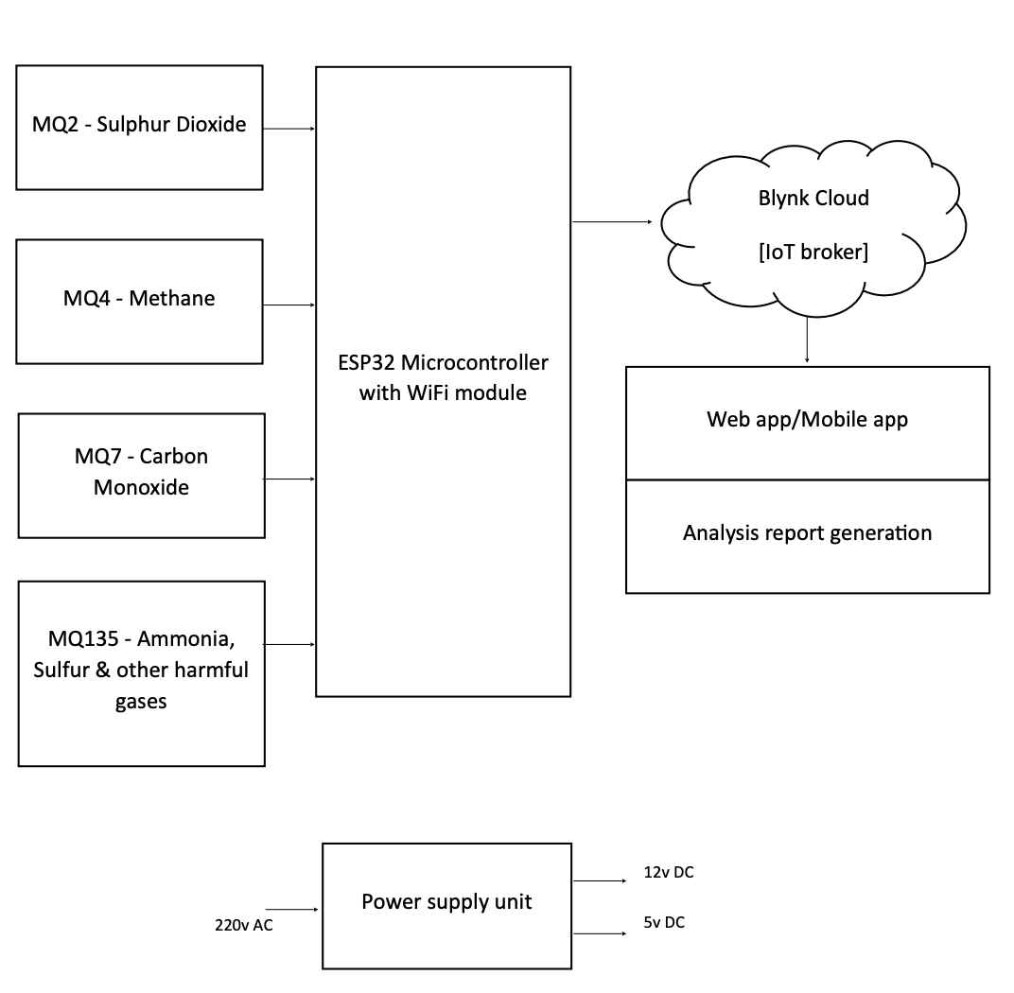
Block Diagram
Fig - 2 : Block Diagram of IoT based Air Pollution Monitoring System

Slide 9
Design
Hardware design :
ESP32 development board will be used as the main controller for the system.
Four gas sensors (MQ2, MQ4, MQ7, and MQ135) will be used to detect the concentration of different gases in the air.
Software design :
The Blynk IoT platform will be used for data visualisation and user interaction.
The Arduino IDE will be used to write the code for the ESP32 board.
The Blynk library will be used to connect the ESP32 board to the Blynk app and send data to it.

Slide 10
Design
System architecture :
The ESP32 board will be the main controller and will collect data from the gas sensors.
The data will be processed and sent to the Blynk app for visualisation and user interaction.
The Blynk app will display the current values of each sensor and will provide alerts if the air quality reaches a hazardous level.
The system will be powered by a USB cable connected to the ESP32 board.

Slide 11
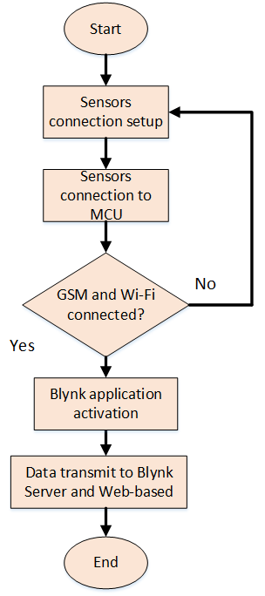
FLOW CHART
The sensors connection setup step involves connecting the MQ2, MQ4, MQ7, and MQ135 gas sensors to the ESP32 microcontroller unit (MCU) in the system.
The next step is to connect the sensors to the MCU, followed by checking if the GSM and Wi-Fi connections are established.
In case the GSM and Wi-Fi connections are not established, the system will return to the sensors connection setup step to ensure the connections are established correctly.
Once the connections are established, the Blynk application is activated, allowing the user to access the data collected by the sensors in real-time.
The collected data is then transmitted to the Blynk server and web-based platforms for monitoring purposes.
The end of the flowchart represents the conclusion of the system's operation.
Fig - 3: Flow Chart

Slide 12
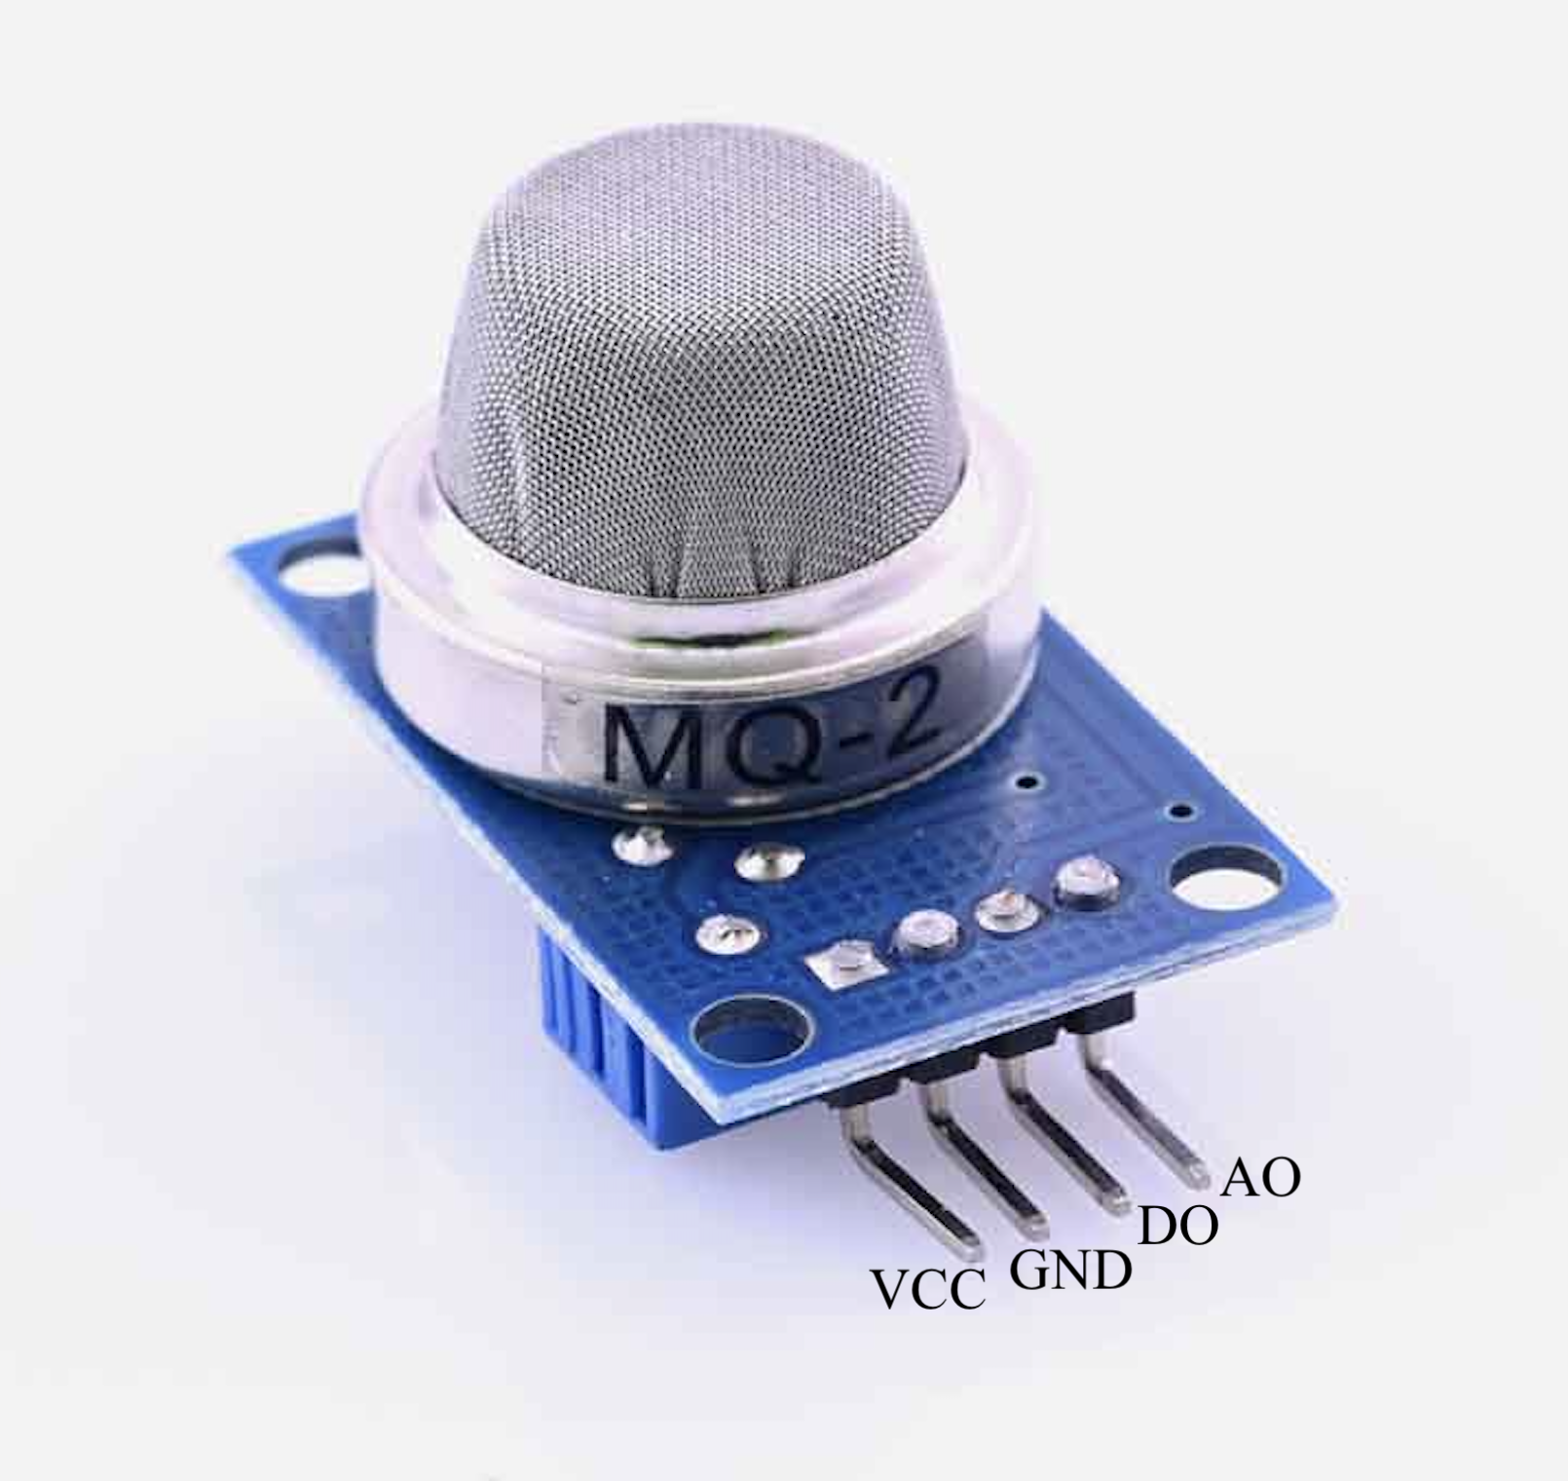
MQ2 Gas Sensor
COMPONENTS DETAIL
It is a MOS (Metal Oxide Semiconductor) sensor, One of the most widely used in the MQ sensor series as shown in the Fig - 4.
The MQ2 sensor uses a sensing material made of tin dioxide (SnO2). When the sensor is exposed to a gas, the SnO2 changes its electrical resistance. The change in resistance is proportional to the concentration of the gas.
The MQ2 gas sensor operates on 5V DC and consumes approximately 800mW. It can detect LPG, Smoke, Alcohol, Propane, Hydrogen, Methane and Carbon Monoxide concentrations ranging from 200 to 10000 ppm.
Fig - 4: MQ2 Gas Sensor

Slide 13
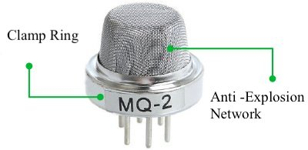
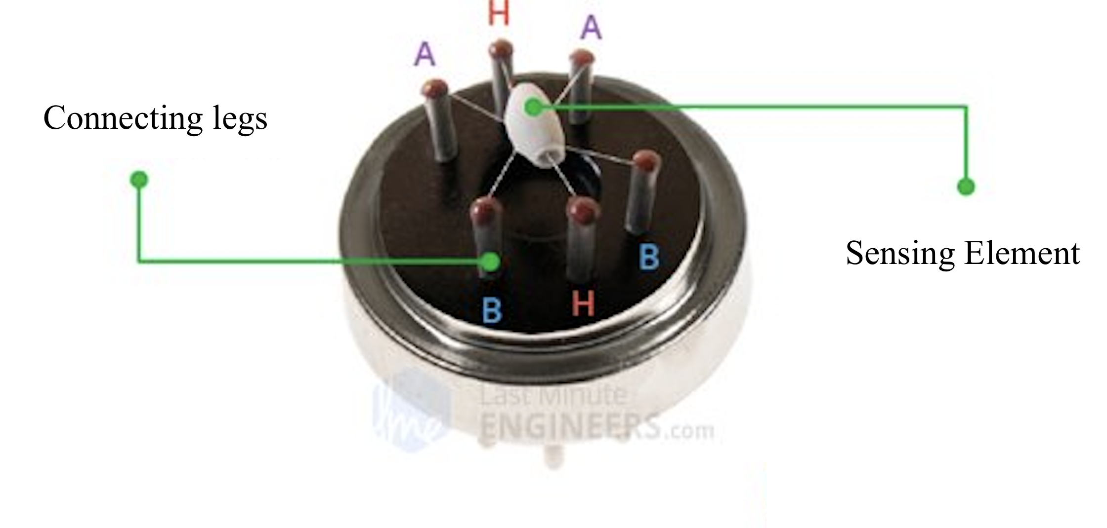
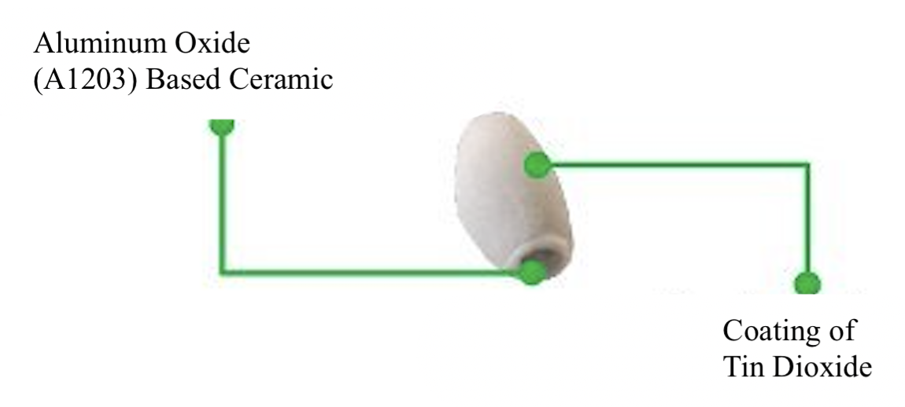
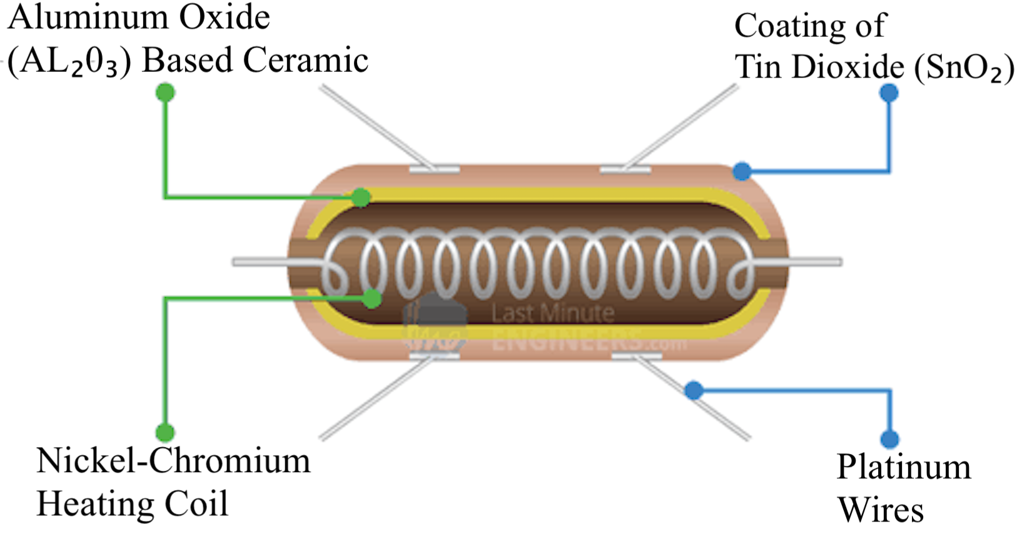
MQ2 Gas Sensor Internal Structure

Slide 14
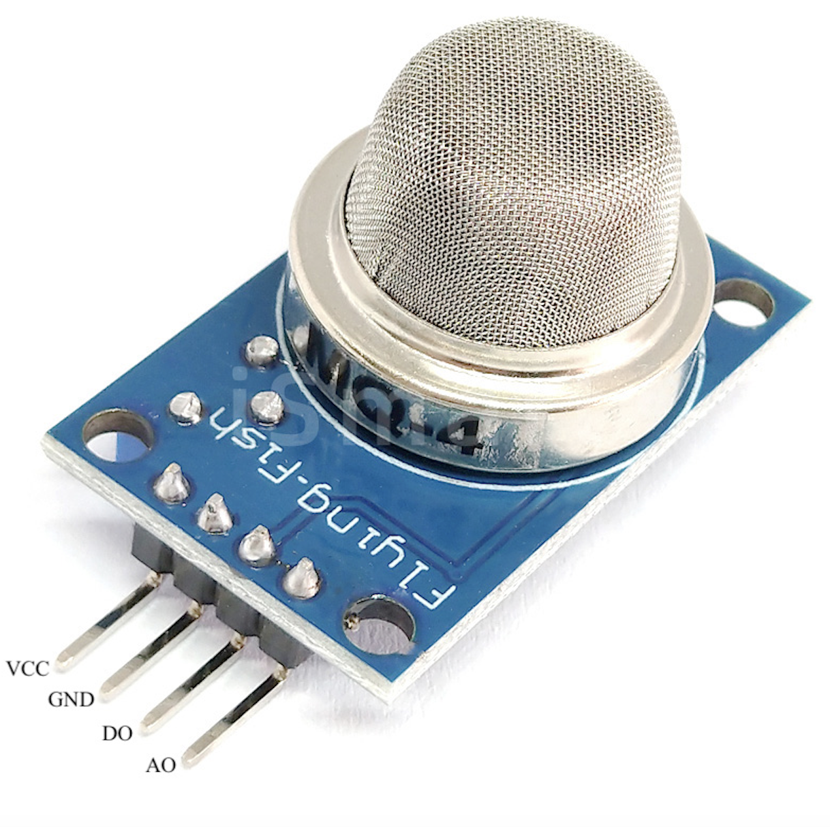
MQ4 Gas Sensor
It is a MOS (Metal Oxide Semiconductor) sensor, used to detect the methane gas concentration within the air at either home or industries & generates output like analog voltage by reading it. as shown in the Fig - 5.
The MQ4 sensor also uses a sensing material made of SnO2. However, the MQ4 sensor is specifically designed to detect methane. The MQ4 sensor is more sensitive to methane than the MQ2 sensor.
Here, the range of concentration for sensing ranges from 300 pm – 10,000 ppm which is appropriate for the detection of a leak.
Fig - 5: MQ2 Gas Sensor

Slide 15
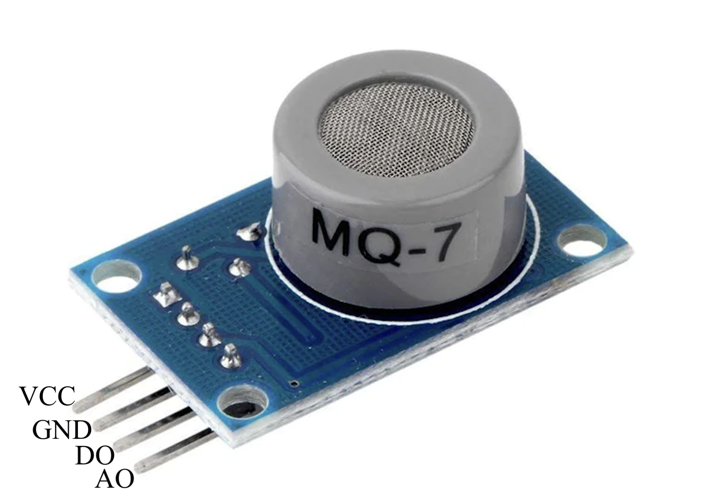
MQ7 Gas Sensor
This Carbon Monoxide (CO) / MQ7 gas sensor is shown in Fig 6, which detects the concentrations of CO in the air and outputs its reading as an analog voltage.
The MQ7 sensor uses a sensing material made of carbon monoxide. When the sensor is exposed to carbon monoxide, the carbon monoxide reacts with the sensing material and changes its electrical resistance. The change in resistance is proportional to the concentration of the carbon monoxide.
The sensor can measure concentrations of 10 to 10,000 ppm.The sensor can operate at temperatures from -10 to 50°C and consumes less than 150 mA at 5 V.
Fig - 6: MQ2 Gas Sensor

Slide 16
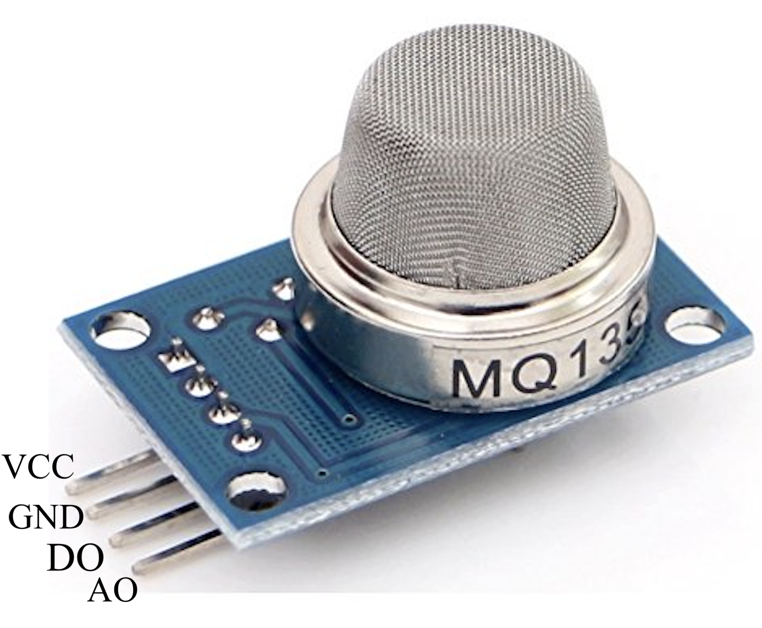
MQ135 Gas Sensor
The MQ-135 Gas sensor is shown in Fig 7, which can detect gases like Ammonia (NH3), sulfur (S), Benzene (C6H6), CO2, and other harmful gases and smoke
The MQ135 sensor uses a sensing material made of titanium dioxide (TiO2). When the sensor is exposed to a gas, the TiO2 changes its electrical resistance. The change in resistance is proportional to the concentration of the gas.
Here, the range of concentration for sensing ranges from 10 pm – 10,000 ppm. The MQ135 air quality sensor module operates at 5V and consumes around 150mA.
Fig - 7: MQ2 Gas Sensor

Slide 17
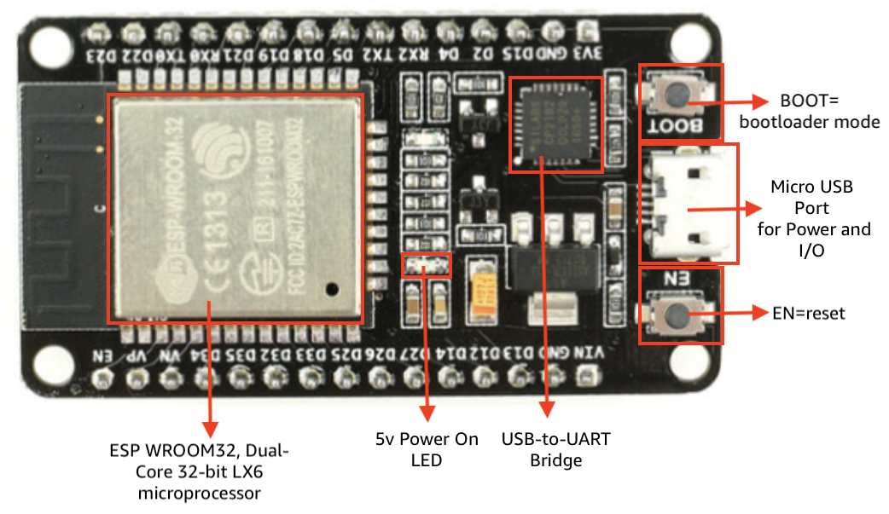
ESP32 MicroController
The ESP32 is a powerful microcontroller with built-in Wi-Fi and Bluetooth capabilities as shown in the Fig - 8, It can be programmed using the Arduino IDE and is widely used for Internet of Things (IoT) applications. The ESP32 module operates at 3.3V. The ESP32 can be powered by a USB cable or an external power source
Some of the key features of the ESP32 microcontroller include:
Xtensa dual-core 32-bit LX6 processor
WiFi and Bluetooth connectivity (including BLE)
Multiple input/output interfaces (GPIO, I2C, SPI, UART, etc.)
Analog-to-digital converters (ADCs) and digital-to-analog converters (DACs)
Secure boot and flash encryption
Fig.8: ESP32 MicroController

Slide 18
WORKING MODEL
The working model of the IoT based air pollution monitoring system involves the following steps:
Sensors Connection Setup: Firstly, all the sensors (MQ2, MQ4, MQ7, and MQ135) are connected to the microcontroller (ESP32) with the help of jumper wires. The connections are made in a way that the analog output pins of the sensors are connected to the analog input pins of the microcontroller.
Sensors Connection to MCU: After connecting the sensors to the microcontroller, the necessary libraries for the sensors are included in the code, and the sensors are initialised. The readings from the sensors are then taken using the analog and digital input pins of the microcontroller.
GSM and Wi-Fi Connected: The ESP32 microcontroller is connected to both GSM and Wi-Fi modules. The Wi-Fi connection is used to transmit the data to the Blynk server, while the GSM connection is used to send SMS notifications to the user in case of hazardous air quality. If both the Wi-Fi and GSM connections are established, the system continues to transmit data to the Blynk server.

Slide 19
WORKING MODEL
Blynk Application Activation: A mobile application is developed using the Blynk platform, which displays the real-time data from the sensors on the user's smartphone. The user can also set threshold values for each pollutant and receive SMS notifications in case the threshold is crossed.
Data Transmit to Blynk Server and Web-based Application: The data obtained from the sensors is transmitted to the Blynk server through the Wi-Fi connection. The data is displayed on the Blynk application in real-time, allowing the user to monitor the air quality from anywhere with an internet connection. Additionally, the data is also sent to a web-based dashboard for easy monitoring.
End: The system continuously monitors the air quality and transmits the data to the Blynk server. The user can monitor the air quality in real-time through the mobile application and receive SMS notifications in case of hazardous air quality.

Slide 20
RESULTS
The developed IoT-based air pollution monitoring system using Blynk and ESP32 microcontroller has shown promising results as shown in Table below, in detecting and monitoring air quality
The system was able to detect the presence of hazardous gases such as CO, CO2, NH3, and benzene that provided real-time data on the mobile / web application developed using Blynk.
The data collected from the system was transmitted to the Blynk server, and the user was able to monitor the data from anywhere in the world using an internet connection.
The application was able to display the concentration levels of various gases in a graphical format, which made it easier for the user to understand the air quality.

Slide 21
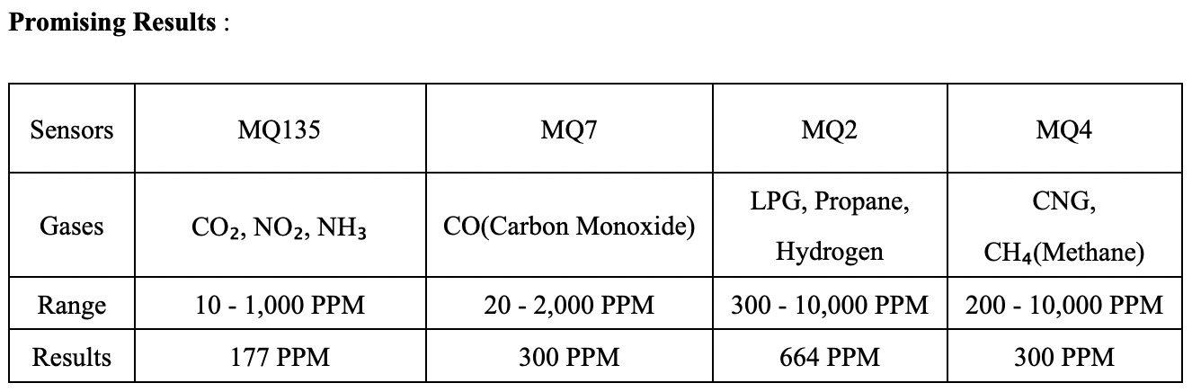
RESULTS
In conclusion, the developed IoT-based air pollution monitoring system using Blynk and ESP32 microcontroller has shown promising results in detecting and monitoring air quality.
The system's reliability, accuracy, and ease of use make it a valuable tool in monitoring air quality and taking necessary actions to improve it. And the exposed level is calculated in PPM (Parts per Million).

Slide 22
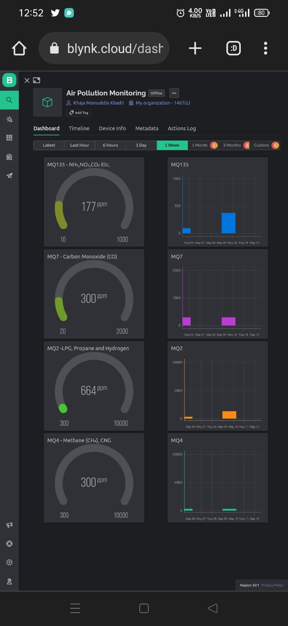
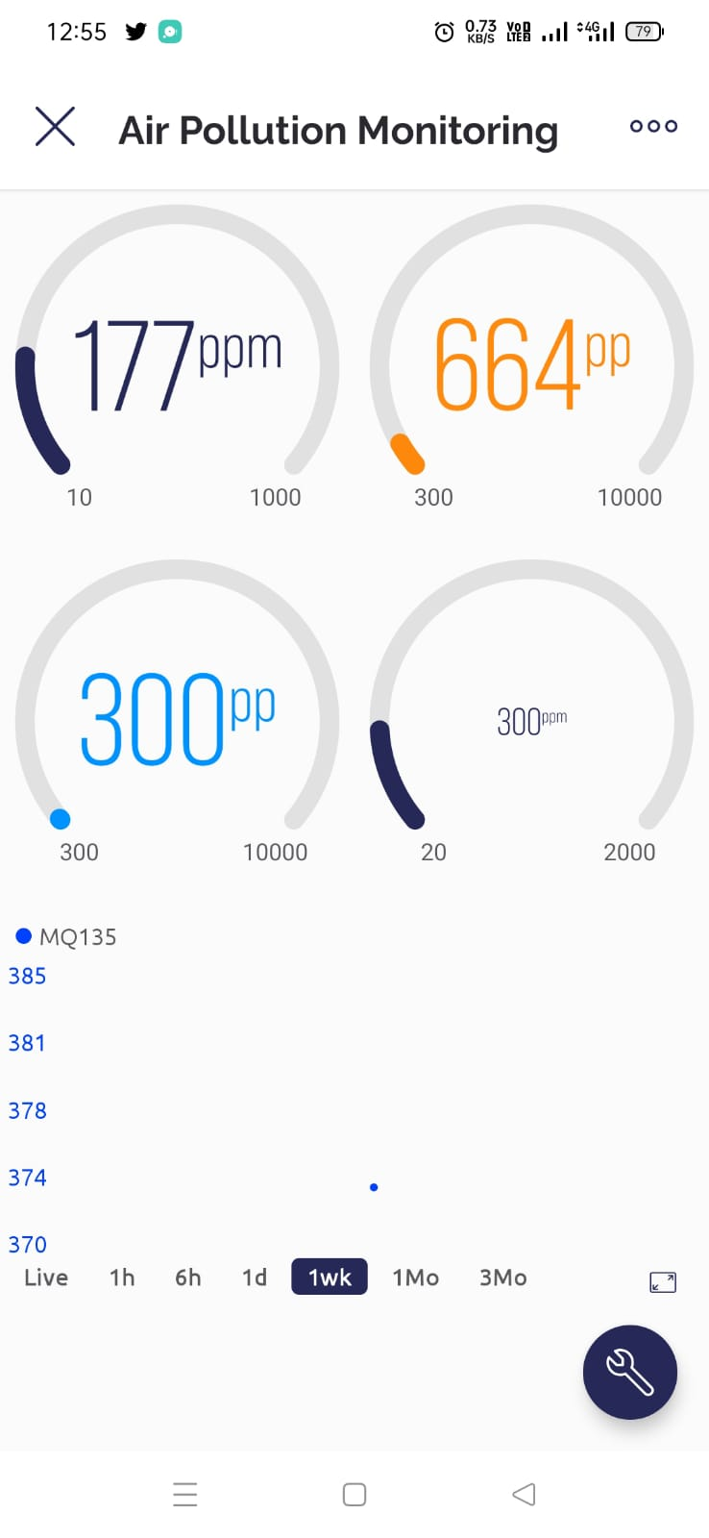
RESULTS
Fig - 9 : Results of the working model with Web And Mobile Application using Blynk

Slide 23
CONCLUSION
In conclusion, an IoT-based air pollution monitoring system is an essential tool that can help individuals and communities better understand the air quality in their surroundings.
By using sensors and connected devices, such a system can gather real-time data on various pollutants, providing valuable insights into the air quality conditions.
The mobile application is developed to monitoring system it tracking the how much the human has exposed in a day. The gas sensors was used for identifying the Leakage Gas, Carbon Monoxide, Smoke, and Propene. The sensor senses the gases and convert from analog to digital and displays in the application. The exposed level is calculated in PPM (Parts per Million).
Overall, an IoT-based air pollution monitoring system can contribute to improving air quality and public health. It can also provide valuable data to policymakers, enabling them to make informed decisions and implement effective strategies to reduce air pollution levels. With the increasing concerns about air pollution and its impact on human health, such systems can play a crucial role in mitigating the adverse effects of air pollution.

Slide 24
FUTURE SCOPE
Integration with smart city infrastructure
Predictive analytics
Low-cost sensors
Mobile apps
Community involvement

Slide 25
References
[1] Kelly, F.J., & Fussell, J.C. (2015). Air pollution and public health: emerging hazards and improved understanding of risk. Environmental and geo chemistry and health, 37(4), 631-49.
[2] TERI. 2015. Air Pollution and Health. Discussion Paper by The Energy and Resource Institute: New Delhi by Rinki Jain (Associate Fellow,TERI), KarnikaPalwa (Research Associate,TERI).
[3] Tudose, D. S., Patrascu, N., Voinescu, A., Tataroiu, R., and Täpus, N., “Mobile Sensors in Air Pollution Measurement”. In Positioning Navigation and Communication (WPNC), IEEE ,pp. 166-170, 7 Apr 2011.
[4] Piyush Patil “Smart IoT Based System For Vehicle Noise And Pollution Monitoring”, International Conference on Trends in Electronics and Informatics ICEI 2017, 978-1-5090-4257.
[5] Poonam Pal, Ritik Gupta, Sanjana Tiwari, Ashutosh Sharma “IoT based Air Pollution Monitoring System using Arduino”, International Research Journal of Engineering and Technology (IRJET), Volume: 04 Issue: 10 | Oct -2017, pp. 1137-1140, 2017
[6] Temesegan Walelign Ayele, Rutvik Mehta, “Air pollution monitoring and prediction using IoT ”, International Conference on Inventive Communication and Computational Technologies (ICICCT 2018), 978-1-5386-1974-2/18.
[7] Vibhutesh Kumar Singh, Himanshu Chandna, Nidhi Upadhyay, “An Internet of Things Based Smart Helmet Design for Potholes and Air Pollution Monitoring”,EAI Endorsed Transactions on Internet of Things, 01 2019 - 04 2019 | Volume 5 | Issue 18 | e2
[8] Shaheduzzaman Chowdhury, MD. Shahedul Islam, Md. Kaiser Raihan and Mohammed Shahriar Arefin, “Design and Implementation of an loT Based Air Pollution Detection and Monitoring System”, International Conference on Advances in Electrical Engineering (ICAEE), 978-1-7281-4934-9/19.
[9] Liang Zhao, Wenyan Wu, Shengming Li, “Design and implementation of an IoT based indoor air quality detector with multiple communication interfaces”, IEEE INTERNET OF THINGS JOURNAL.
[10] S.Muthukumar, W.Sherine Mary, Jayanthi.S, Kiruthiga.R, Mahalakshmi.M, “IoT based air pollution monitoring and control system“, Proceedings of the International Conference on Inventive Research in Computing Applications (ICIRCA 2018), ISBN:978-1-5386-2456-2

Slide 26
THANK YOU

